Slide 1
Vision Based Automation
Digital image processing
Introduction

Slide 2
Motivation
Improvement of pictorial information for human interpretation
Processing of image data for storage, transmission and representation for autonomous machine perception

Slide 3
What is DIP?
Image: Projection of 3D scene into 2D plane
Definition of an image: A 2D function f(x,y) where x and y are spatial coordinates and f at any pair of coordinates (x,y) is called as the intensity or gray level of the image at that point

Slide 4
Types of images
Depending on the function value f there are two types of images
Analog
Digital
Analog image: When the values of f (x,y) are in continuous range Eg. Analog Oscilloscope CRT monitor.
Disadvantage: Memory requirement is high for storing analog images.

Slide 5
Types of image cont’d
Digital image: When the values of x, y ,f are all finite in nature and discrete quantities than it is called digital image
In general all images are analog in nature but for storage and transmission we need to convert to digital
Analog Image
Sampling
(x, y) parameter
Digital Image
Quantization
f parameter

Slide 6
Digital images
Digital images contain finite number of elements, each of which has particular location and value
These elements are called picture elements, image elements, pels or pixels
Advantages of digital images: Fast processing, cost effective, effective storage, efficient transmission, scope for versatile image manipulation
Disadvantages: High memory and fast processors

Slide 7
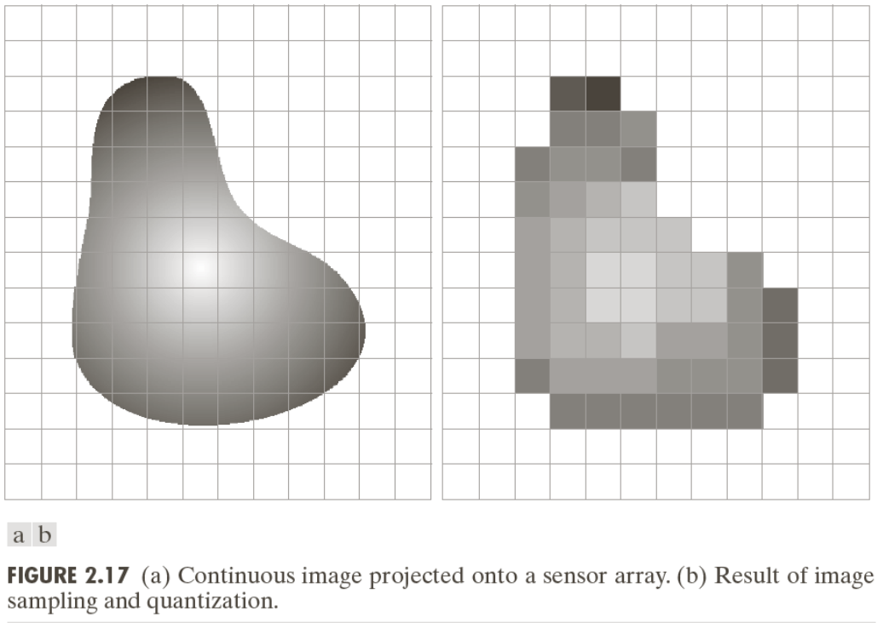
Sampling and Quantization

Slide 8
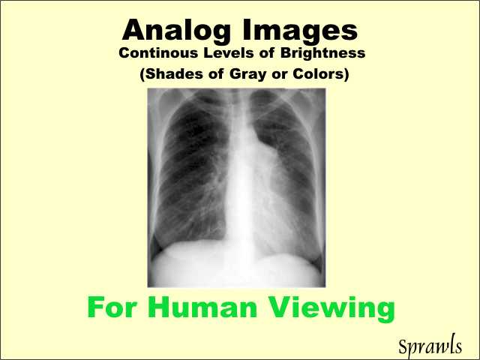
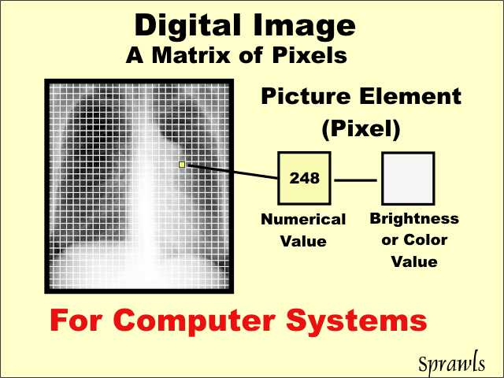
Analog and Digital image

Slide 9
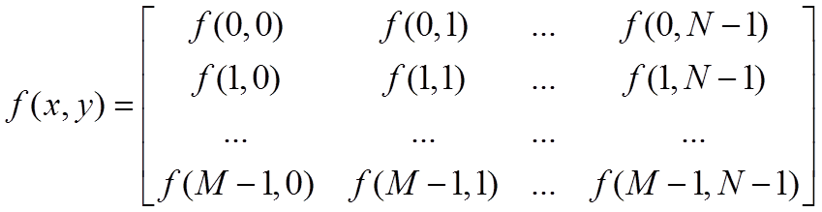
Representation of Digital images
The representation of an M×N numerical array as

Slide 10

Digital Image formats
Common image formats include:
1 sample per point (B&W or Grayscale)
3 samples per point (Red, Green, and Blue)
4 samples per point (Red, Green, Blue, and “Alpha”, a.k.a. Opacity)

Slide 11
Digital image processing
Analysis and manipulation of a digitized image especially in order to improve its quality
Processing of digital images by means of a digital computer or specific application

Slide 12
Advantages of DIP
Humans are limited to visual band of the electromagnetic spectrum
Imaging machines cover almost entire EM spectrum ranging from gamma to radio waves
Due to DIP one can operate on images generated by sources that humans are not capable of to sense like ultrasound, electron microscopy and computer generated images

Slide 13
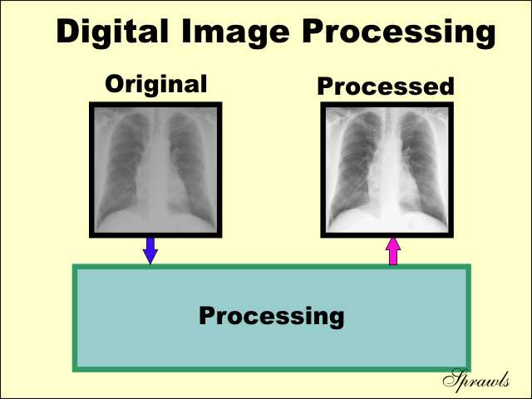
Digital Image processing

Slide 14
Scope of Digital Imaging processing
Useful paradigm in the world of images, considering 3 types of computerized processes:
Low level image processing
Mid level image processing
High level image processing

Slide 15
Low level image processing
It involve primitive operations such as image pre-processing, noise reduction, contrast enhancement and image sharpening
Low level image processing is characterized by the fact that both the input and output are images

Slide 16
Mid Level image processing
Involve tasks such as segmentation, description of those objects to reduce them to suitable form for computer processing and classification of individual tasks
Mid level image processing is characterized by the fact that the input is an image and outputs are attributes extracted from those images (Ex. Edges, contours and individual objects)

Slide 17
High Level Image processing
Object recognition
Pattern recognition
Pattern classification

Slide 18
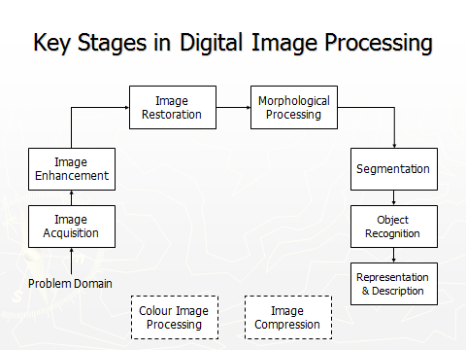

Slide 19
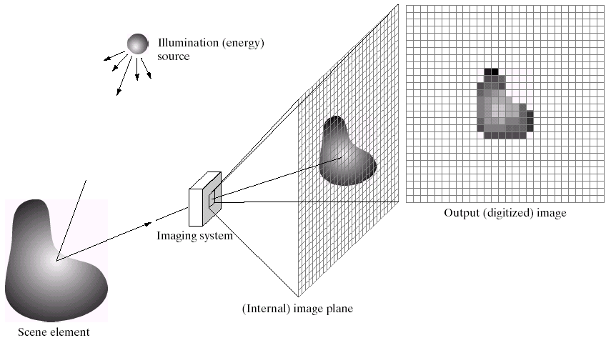
Key Stages in Digital Image Processing: Image Aquisition
Image Restoration
Morphological Processing
Image Enhancement
Segmentation
Image Acquisition
Object Recognition
Representation & Description
Problem Domain
Colour Image Processing
Image Compression

Slide 20
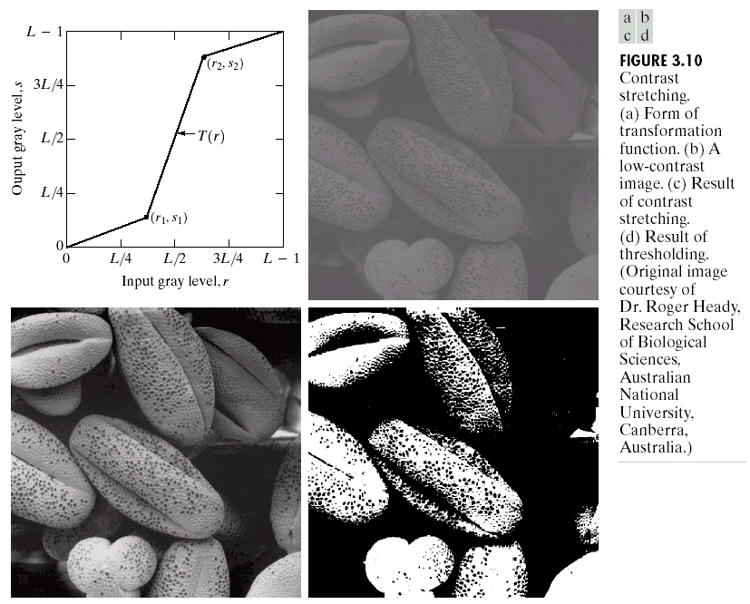
Key Stages in Digital Image Processing: Image Enhancement
Image Restoration
Morphological Processing
Image Enhancement
Segmentation
Image Acquisition
Object Recognition
Representation & Description
Problem Domain
Colour Image Processing
Image Compression

Slide 21
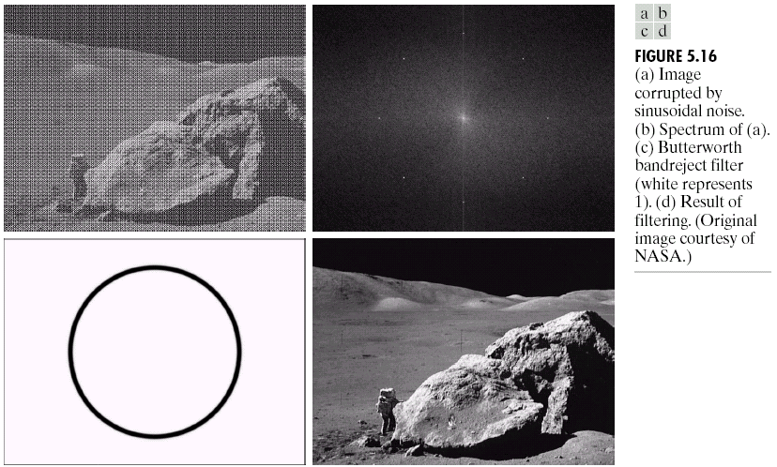
Key Stages in Digital Image Processing: Image Restoration
Image Restoration
Morphological Processing
Image Enhancement
Segmentation
Image Acquisition
Object Recognition
Representation & Description
Problem Domain
Colour Image Processing
Image Compression

Slide 22
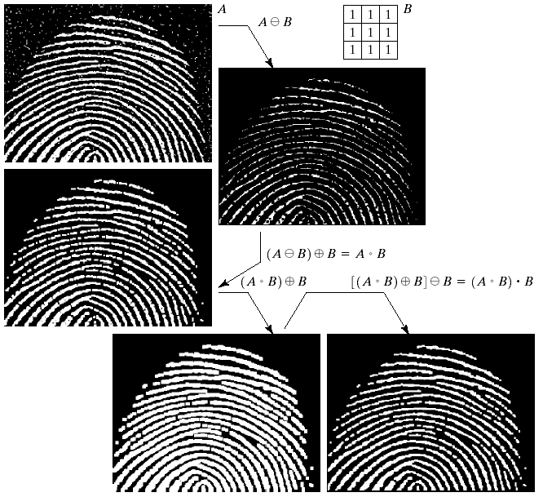

Key Stages in Digital Image Processing: Morphological Processing
Image Restoration
Morphological Processing
Image Enhancement
Segmentation
Image Acquisition
Object Recognition
Representation & Description
Problem Domain
Colour Image Processing
Image Compression

Slide 23
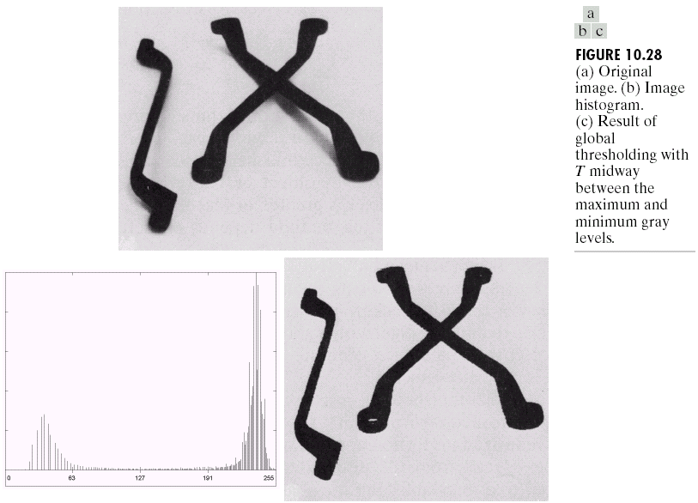
Key Stages in Digital Image Processing: Segmentation
Image Restoration
Morphological Processing
Image Enhancement
Segmentation
Image Acquisition
Object Recognition
Representation & Description
Problem Domain
Colour Image Processing
Image Compression

Slide 24
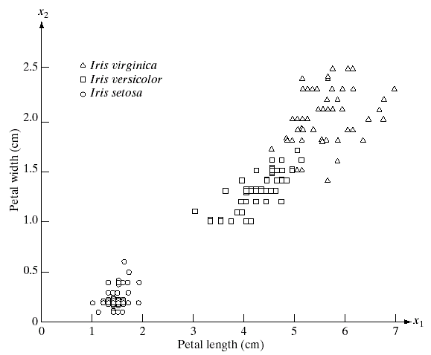
Key Stages in Digital Image Processing: Object Recognition
Image Restoration
Morphological Processing
Image Enhancement
Segmentation
Image Acquisition
Object Recognition
Representation & Description
Problem Domain
Colour Image Processing
Image Compression

Slide 25
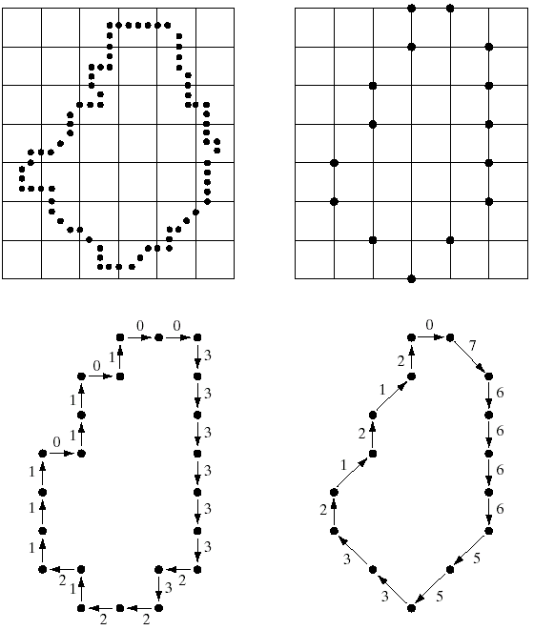
Key Stages in Digital Image Processing: Representation & Description
Image Restoration
Morphological Processing
Image Enhancement
Segmentation
Image Acquisition
Object Recognition
Representation & Description
Problem Domain
Colour Image Processing
Image Compression

Slide 26
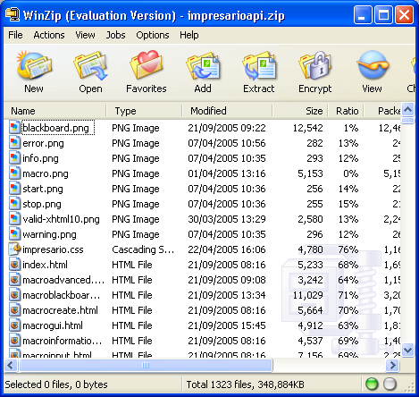
Key Stages in Digital Image Processing: Image Compression
Image Restoration
Morphological Processing
Image Enhancement
Segmentation
Image Acquisition
Object Recognition
Representation & Description
Problem Domain
Colour Image Processing
Image Compression

Slide 27
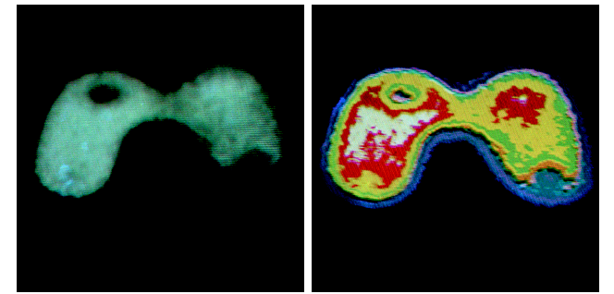
Key Stages in Digital Image Processing: Colour Image Processing
Image Restoration
Morphological Processing
Image Enhancement
Segmentation
Image Acquisition
Object Recognition
Representation & Description
Problem Domain
Colour Image Processing
Image Compression

